Slide 1
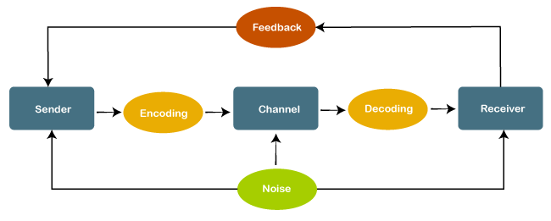
Assumption: Process of Communication

Slide 2
Art/Literature: Builds on the Ambiguities of Communication
Everyday Communication replicates these grey areas

Slide 3
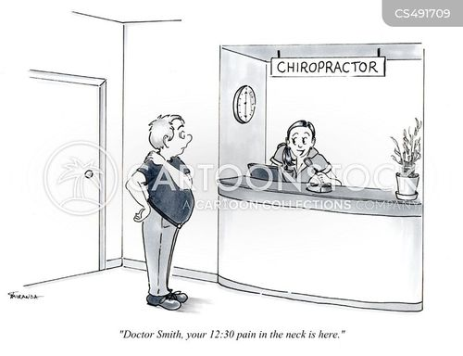

Slide 4
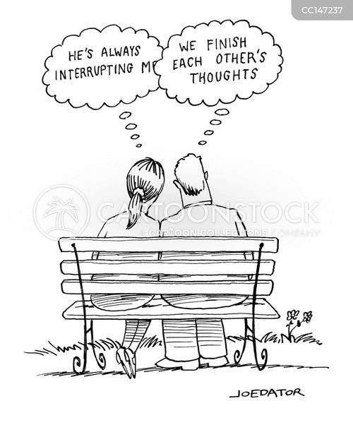

Slide 5
Range of Interpretations (Meanings/Feelings)

Slide 6
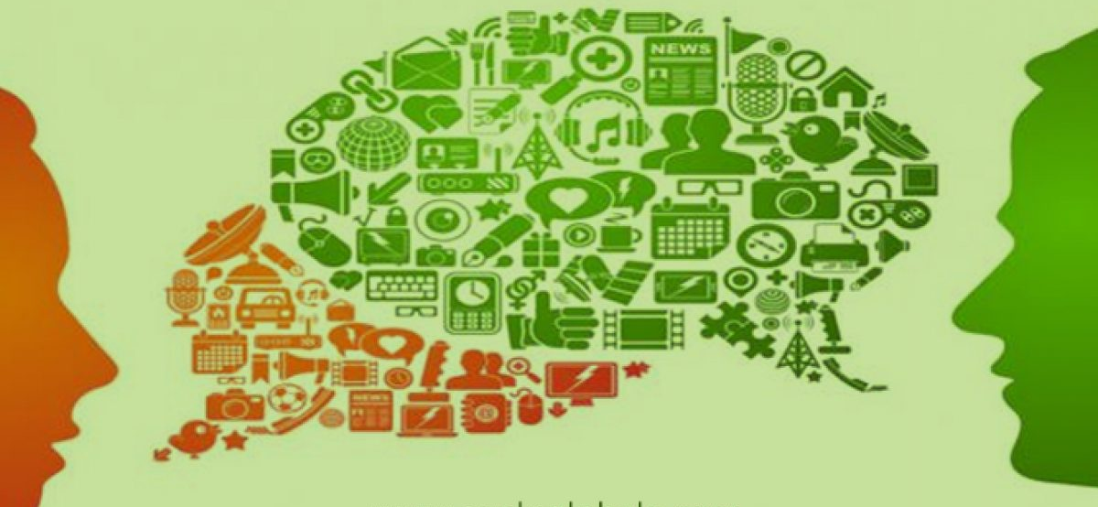
Overlapping Mind-Maps

Slide 7
NOT really the process of Communication!

Slide 8


Slide 9
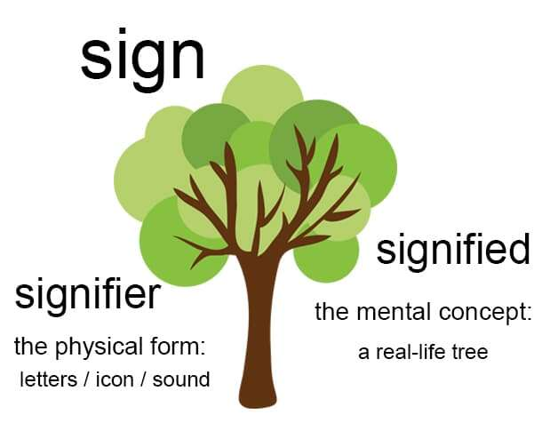
Conventional definition of language:
NOT as straightforward
Meanings: Ambiguous, shifting, individual
What must we do?
(to guarantee productivity and safety)
Appreciate multiplicity of interpretation
Anticipate the possibility of misinterpretation
Ensure uninterrupted communication

Slide 10
Communication
Clarity
Coherence/Cogency
Concision
Concreteness
Correctness
Completeness

